Slide 1

Predicting the future of Real Estate Housing Market
Fintech project-01

Slide 2
Motivation & Summary
The real estate industry has long operated according to its own traditions, but the availability of huge volumes of data is revolutionizing the way the industry works. Big data analysis techniques are creating a new real estate market in which both customers and agents are better informed than ever before

Slide 3
Question Being Asked by the Investment Community
Is 2021 a good year to buy a house?
Where should one buy a house?
Will secondary cities that have historically been overlooked but are attractive to dynamic young populations become popular?
How will commercial real estate be affected by telecommuting and declining automobile ownership?
Will climate change render waterfront property worthless or spur innovations that enable a different relationship to aquatic environments?

Slide 4
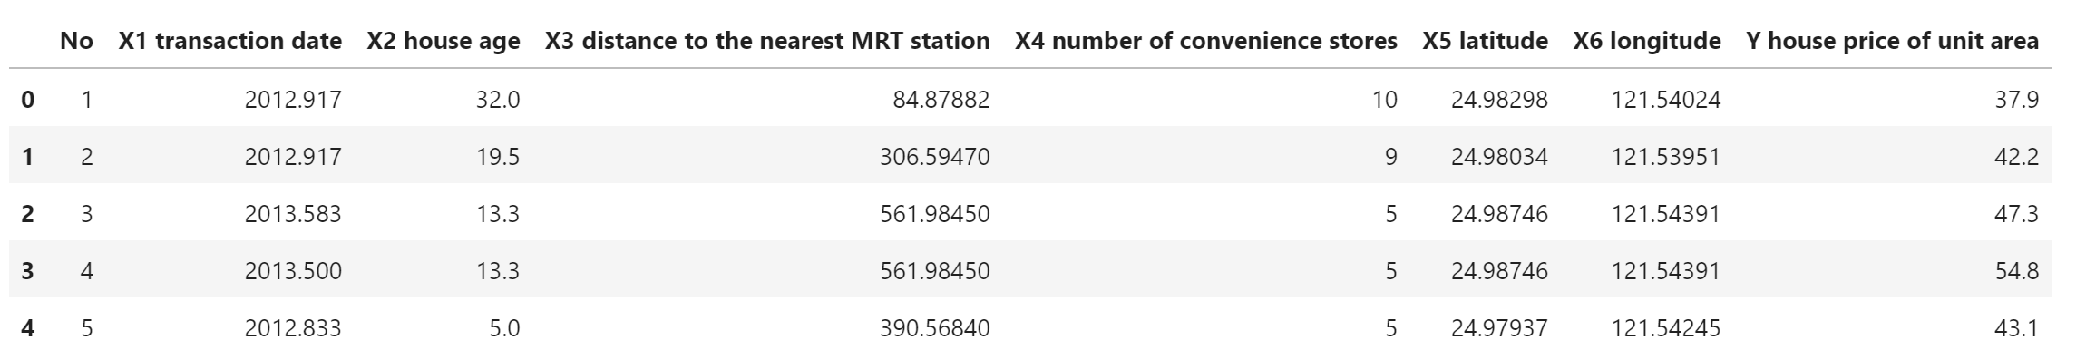
US House Price Prediction 2021

Slide 5

Initial Data Clean up
Utilized Juypter lab using python to eliminate unneccary data.

Slide 6
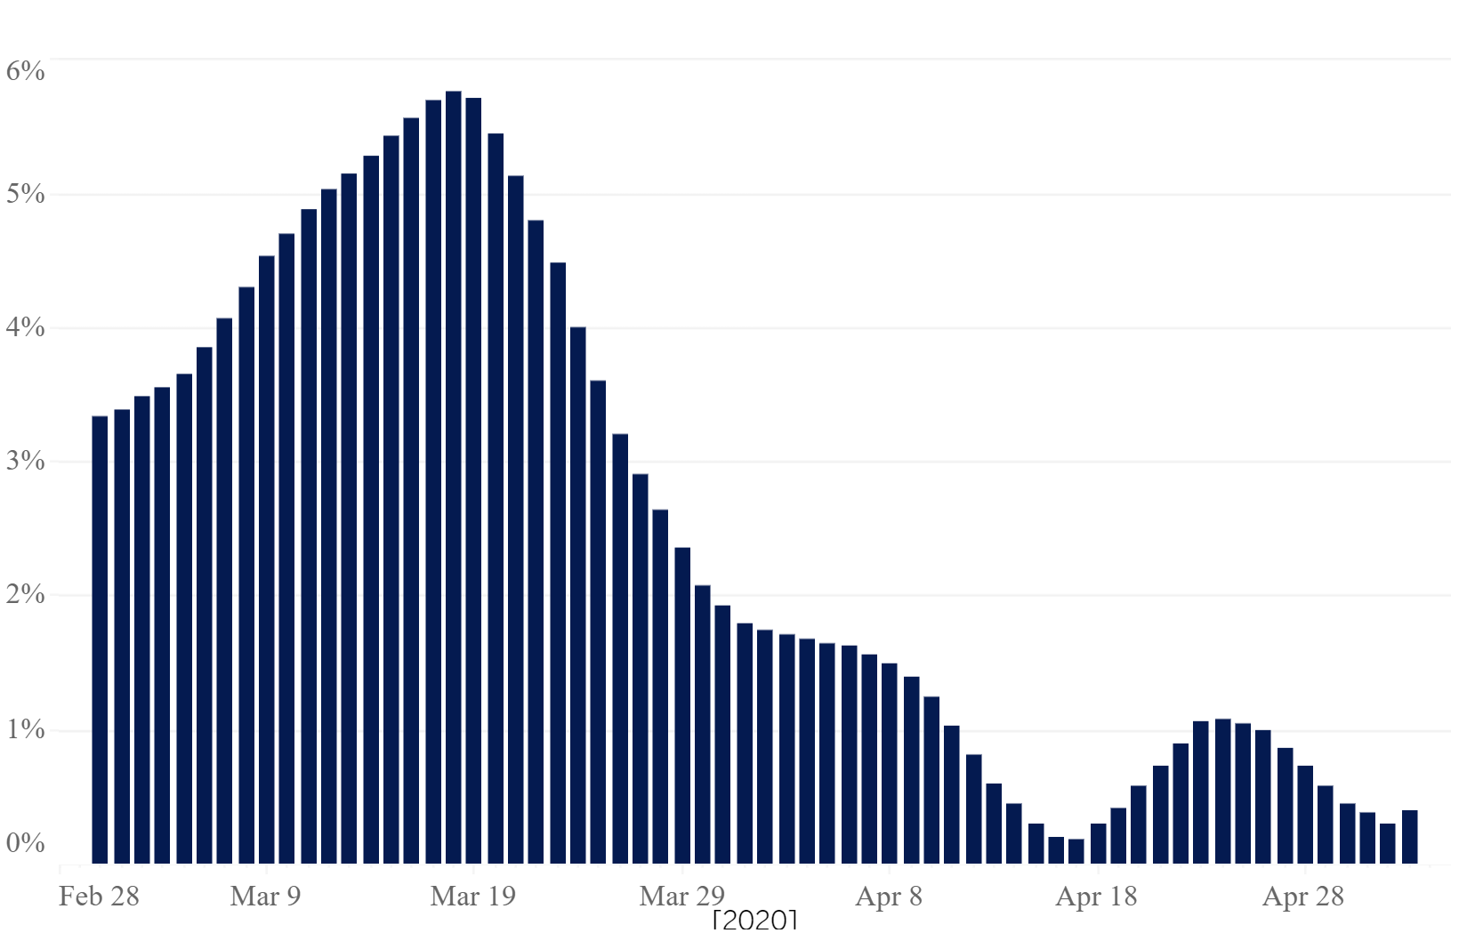
Most Affordable Housing In the US
Determining in 2020 the kind of homes being listed offered some early clues as to the resilience of the market and any potential future impacts on home prices as the enduring impacts of the coronavirus crisis unfold. The early difference emerging show that sellers were balancing their decision to sell different at different price points.

Slide 7
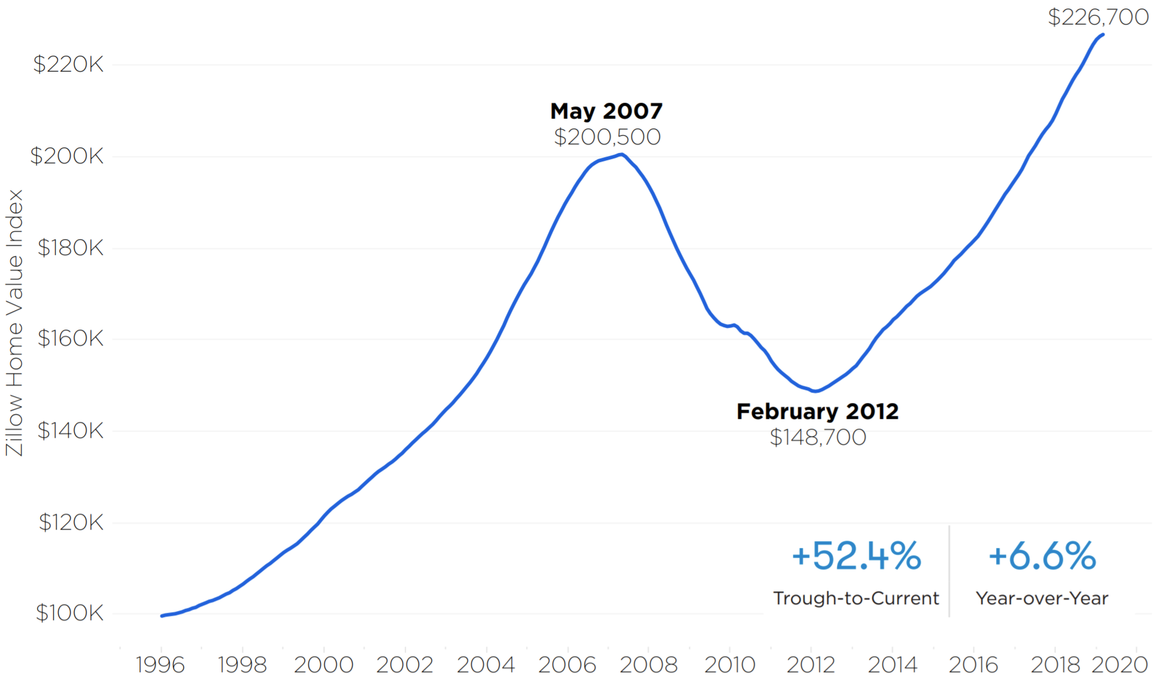
Home Value Index
US home values surpassed pre-recession highs.

Slide 8
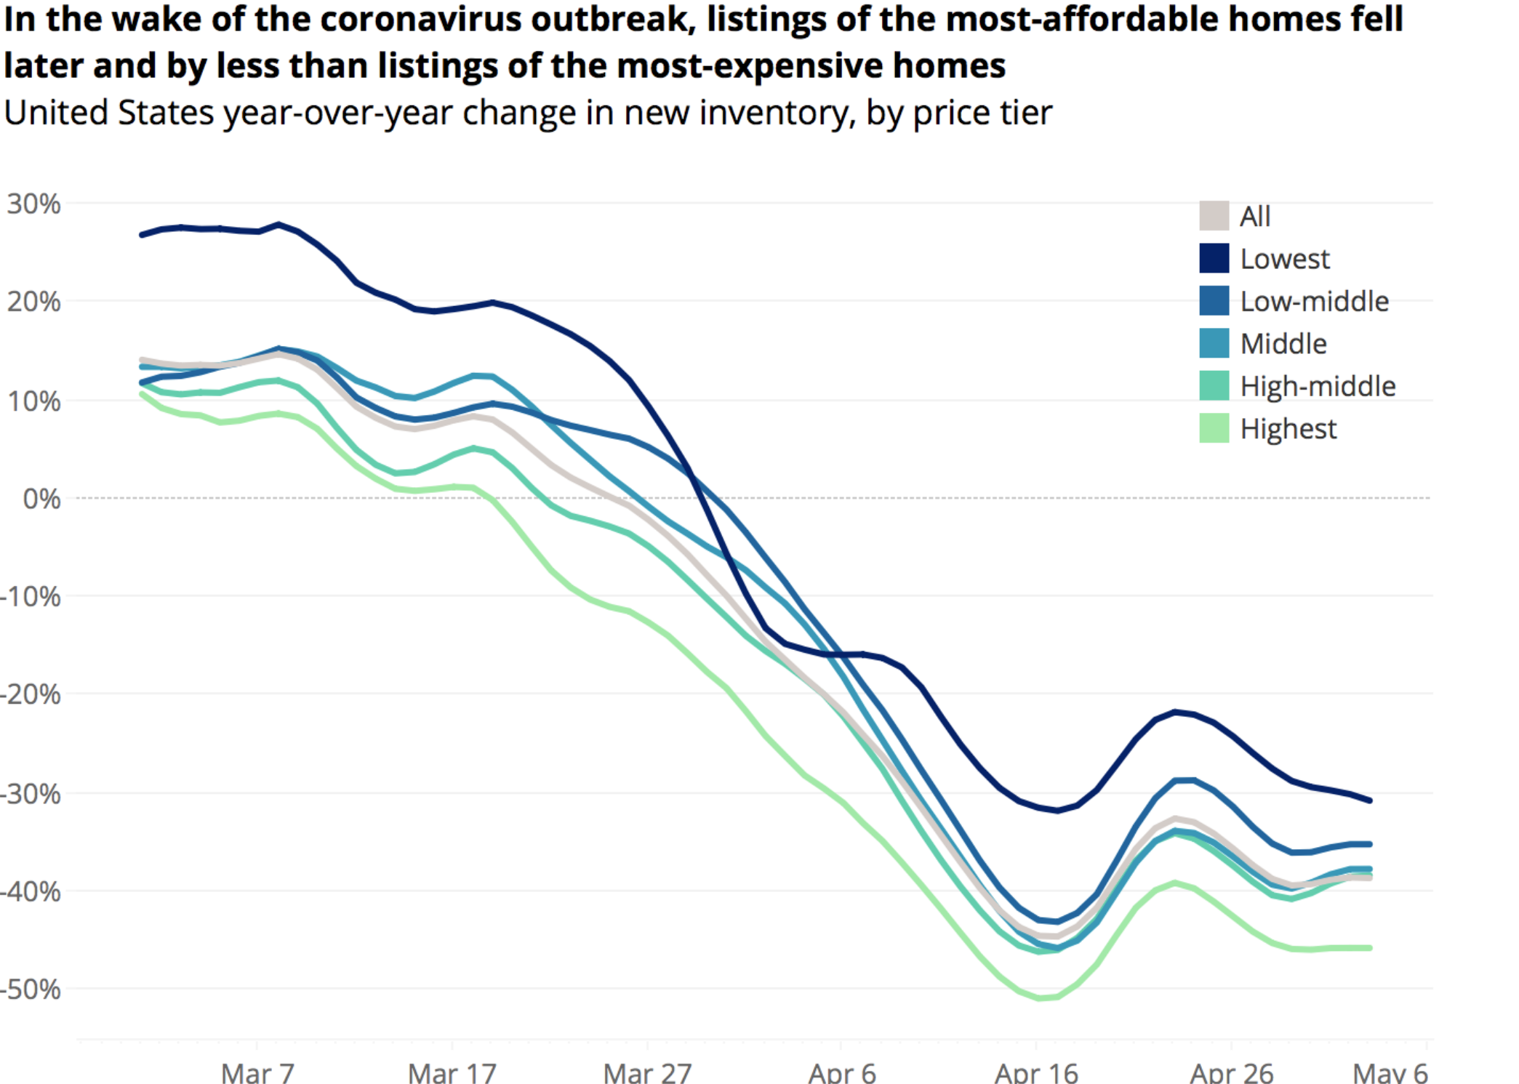
Fewer expensive listings
In 2020 seems fewer expensive listings seems to be helping to push down median list price within the US

Slide 9
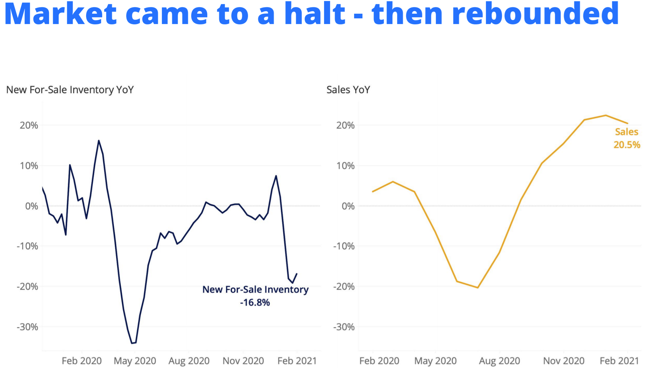
2020 Market
In 2020 the market came to a hault and then rebounded.

Slide 10
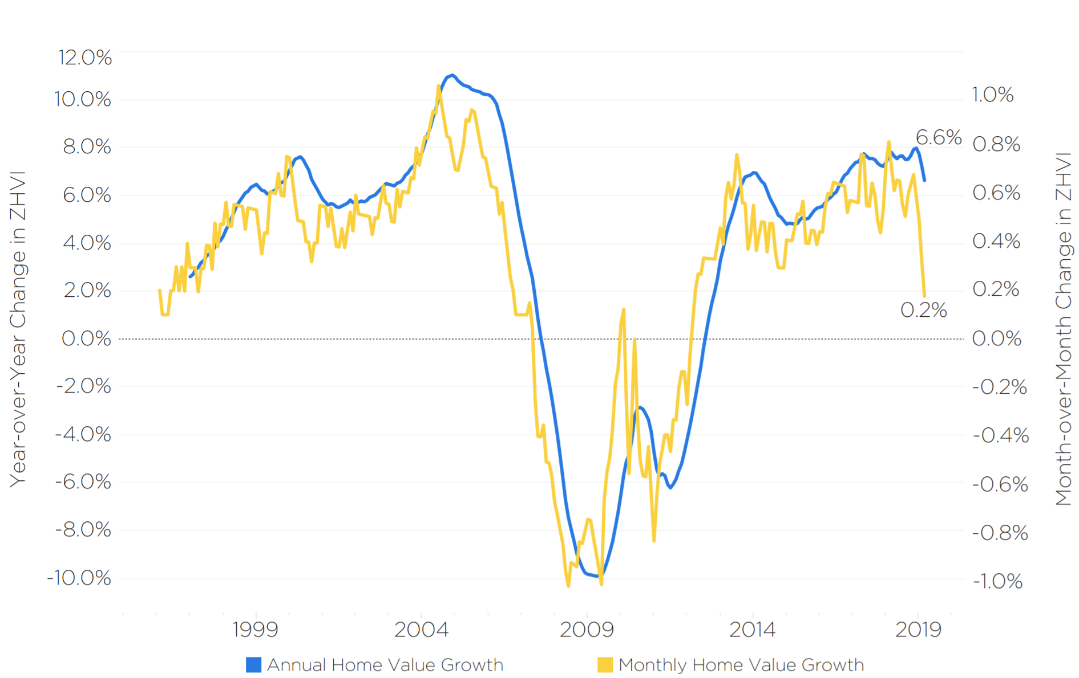
2020 Market
In 2020 the market came to a hault and then rebounded.

Slide 11
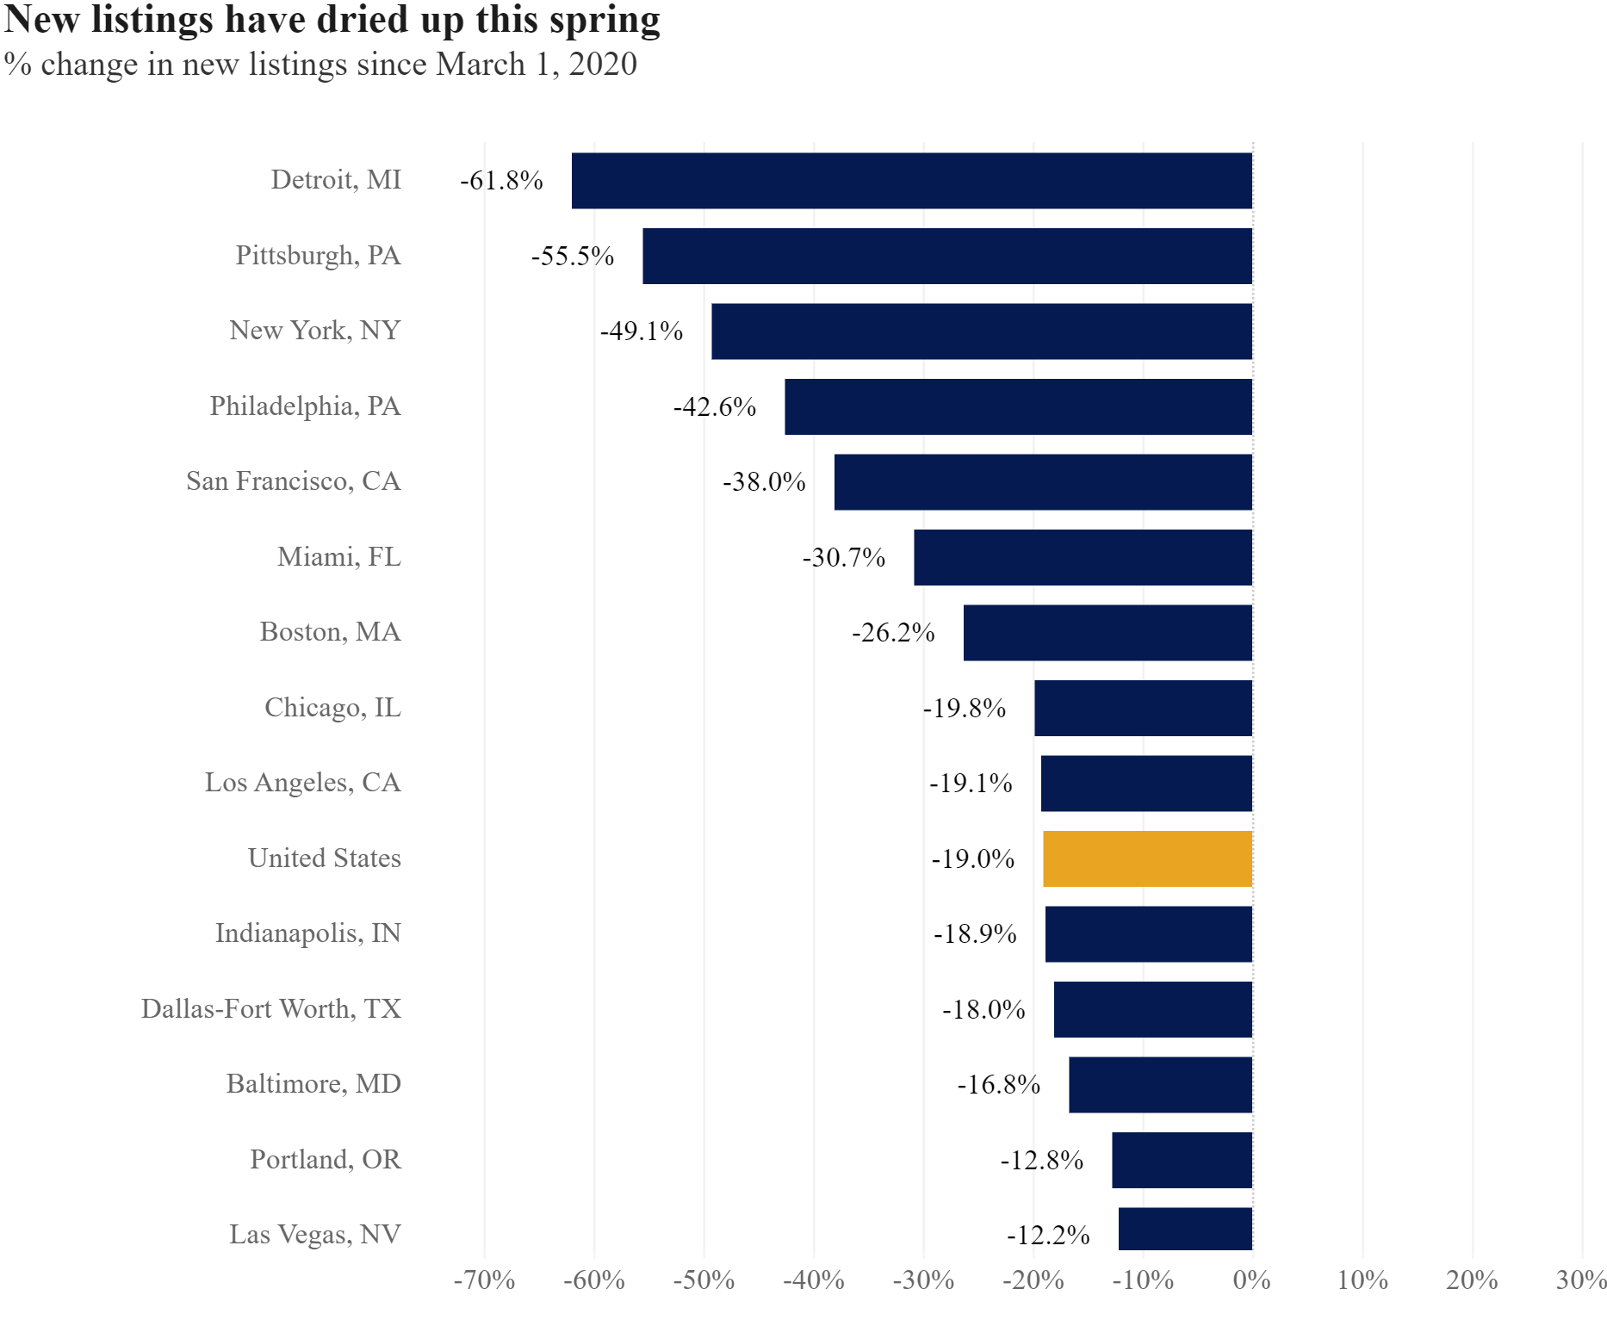
New Listings
In Spring 2020 new listings

Slide 12
Conclusion
U.S. home values are growing at a steady pace, and have surpassed prerecession highs nationally and in a number of large markets. Driven largely by limited inventory and high demand, home values are growing fastest at the bottom end of the market.
Regionally, markets in the Midwest and Southeast are outperforming markets along the east and west coasts
Growth in U.S. rents has slowed considerably over the past couple of years and has largely stabilized. Markets in the Southwest are leading national rent growth

